Slide 1


coffee cafe financial sales dashboard
Overview dashboard

Slide 2


Cococoffie Cafe achieved a total revenue of 203K, supported by a healthy total profit of 64K.
The business maintained an impressive average margin of 102.42, reflecting strong pricing and cost control.
Operating expenses totaled 57K, leaving room for consistent profitability.
On average, 30.43 was invested in marketing, indicating a measured approach to promoting the brand while keeping costs efficient.

Slide 3

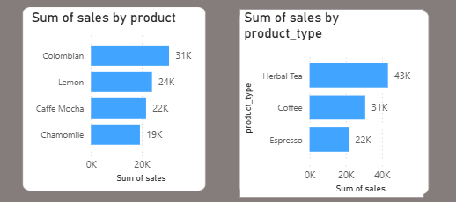
Colombian coffee leads individual product sales at 31K, followed by Lemon (24K), Caffe Mocha (22K), and Chamomile (19K).
When grouped by product type, Herbal Tea dominates with 43K in sales, surpassing Coffee at 31K and Espresso at 22K.
This indicates that while Colombian coffee is the top single item, Herbal Tea as a category is the strongest overall performer, suggesting significant consumer preference toward tea-based options.

Slide 4

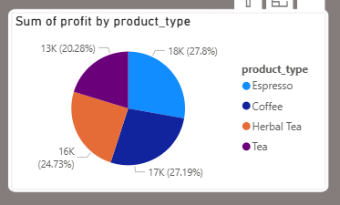
Profit contributions are fairly balanced across product types, with Coffee leading at 27.8% (18K), followed closely by Espresso at 27.19% (17K) and Herbal Tea at 24.73% (16K).
Tea accounts for 20.28% (13K) of total profits.
This distribution shows that while Coffee has the highest profitability, Espresso performs almost equally well despite lower sales, highlighting it as a strong margin product.

Slide 5
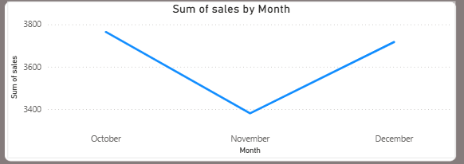
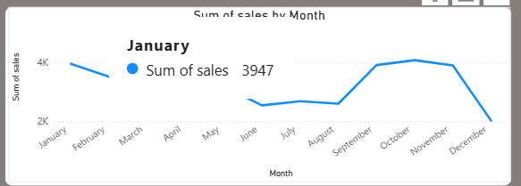
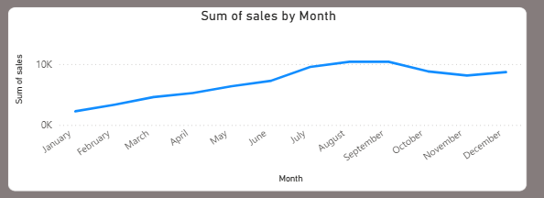
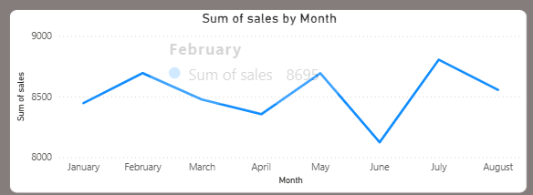
The monthly sales trend shows steady growth from January through May, followed by a slight plateau in June.
A sharp increase is seen in July and August, peaking at over 21K sales in August.
However, September experiences a steep drop to the lowest point of the year.
Sales recover partially in October but then decline gradually in November and December, indicating a seasonal slowdown toward year-end.

Slide 6
